Slide 1


Project name: TI deep sea diver .. Team members:.. Mickey, Donald …

Slide 2
Project description (use pictures and diagrams to describe)
Problem statement: “Deep sea diving is very dangerous and we need a way to enable it while reducing harm to humans. With more and more underwater projects (oil and gas, server farms, food sources etc)”

Slide 3
Project description (use pictures and diagrams to describe)
Solution proposal: “Develop nimble and relatively inexpensive robots that can do the majority of the tasks a human can, initially under the direction of a human and eventually more independantly”

Slide 4
Diagram of subsystems and interface (use colors or other to show ownership)

Slide 5
-Subsystem(s) Name-
Team Member 1
Accomplishments since the last presentation <XX> hrs (track your hours) | Ongoing progress/problems and plans until the next presentation
Subsystem Picture, Sketch, or Graph (1 per team member)

Slide 6
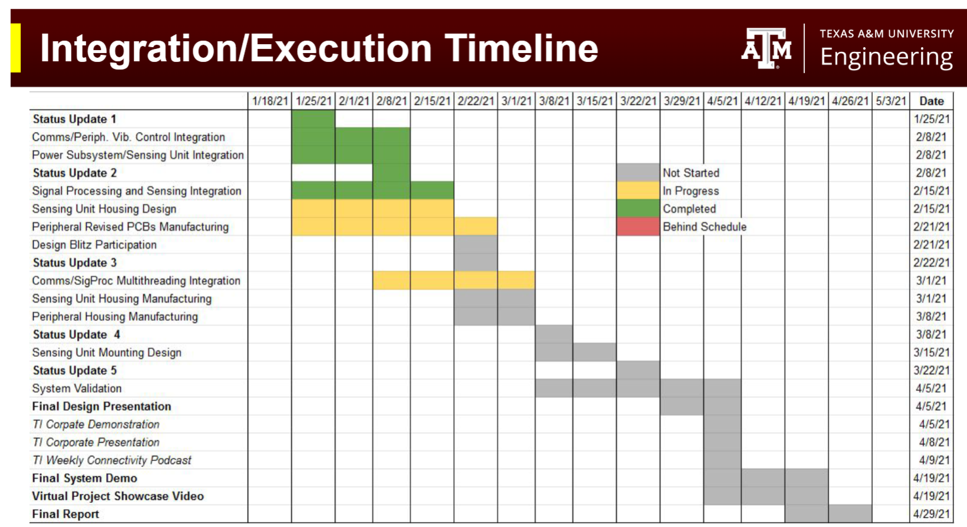
Execution plan
Updated to show progress or slip…highlight differences

Slide 7
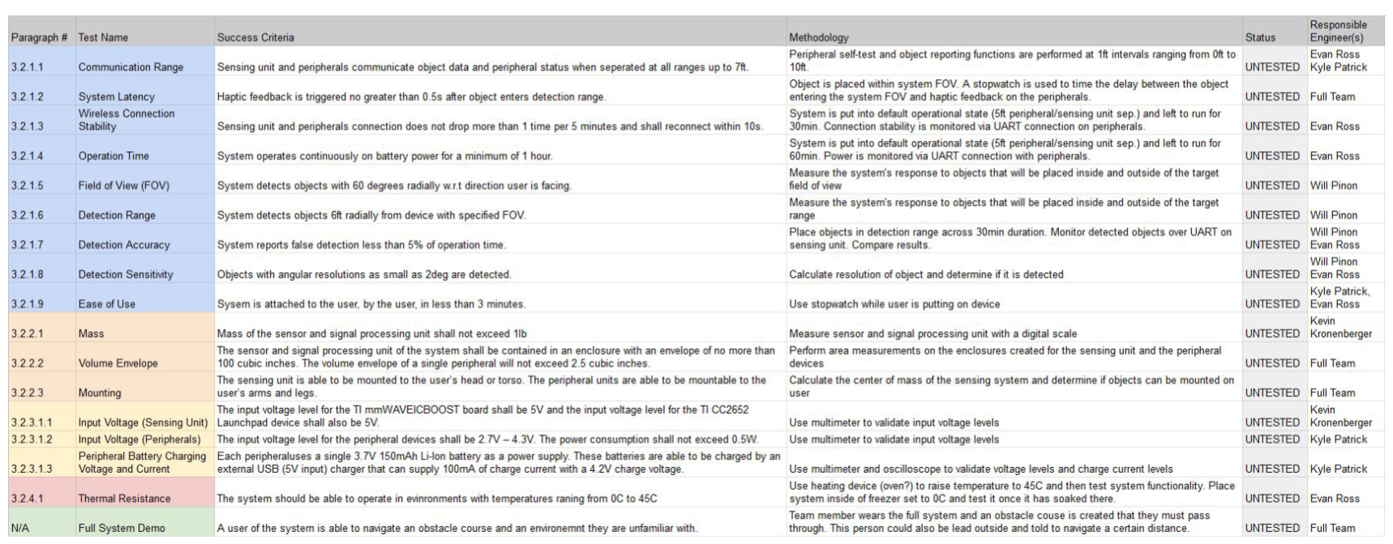
Validation plan
Update Validation Plan….what has been tested?

